Slide 1

Professional Practices (HUM-305)
SPRING SEMESTER 2026
By
Prof Engr Muhammad Raheel Iqbal Butt
Resource Person
Contact: +92 321 7433568
School of Computer & Information Technology
Beaconhouse National University, Lahore

Slide 2
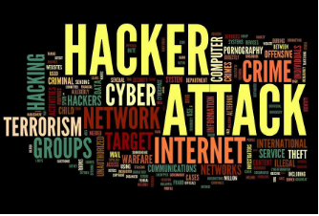

Slide 3
Chap 5: Crime Hacking
What is “Hacking”?
Hacktivism, or Political Hacking
Hackers as Security Researchers
Hacking as Foreign Policy
The Law: Catching and Punishing Hackers
Identity Theft and Credit Card Fraud
Stealing Identities
Responses to Identity Theft
Biometrics
Whose Laws Rule the Web?
When Digital Actions Cross Borders
Libel, Speech, and Commercial Law
Culture, Law, and Ethics
Potential Solutions

Slide 4
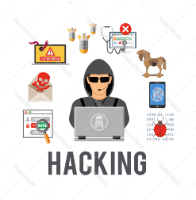

Slide 5
What is “Hacking”?
Definition
Hacking refers to gaining unauthorized access to computer systems, networks, or data.
It involves exploiting software vulnerabilities, weak passwords, or security gaps.
Types of Hackers
White Hat Hackers – Ethical hackers who improve security.
Black Hat Hackers – Malicious hackers who steal or damage data.
Gray Hat Hackers – Hackers who access systems without permission but may not intend harm.

Slide 6
What is “Hacking”?
Common Techniques
Phishing attacks
Malware installation
Password cracking
Network intrusion
Impact
Data theft
Financial losses
Privacy violations
National security risks

Slide 7
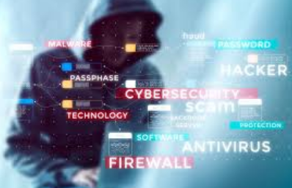

Slide 8
Hacktivism (Political Hacking)
Definition
Hacktivism is the use of hacking techniques to promote political or social causes.
Objectives
Protest against governments or corporations
Promote political ideologies
Expose corruption or injustice
Common Activities
Website defacement
Data leaks
Distributed Denial-of-Service (DDoS) attacks
Examples
Political protest hacking groups
Campaigns against censorship or surveillance
Debate
Supporters: Digital activism
Critics: Cybercrime and illegal disruption

Slide 9
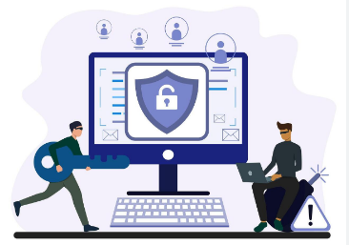

Slide 10
Hackers as Security Researchers
Role
Many hackers work as ethical security researchers.
Purpose
Identify vulnerabilities in systems
Prevent cyberattacks
Strengthen cybersecurity defenses
Activities
Penetration testing
Vulnerability scanning
Responsible disclosure of security flaws
Benefits
Improves software security
Protects users from cyber threats
Helps organizations strengthen defenses

Slide 11
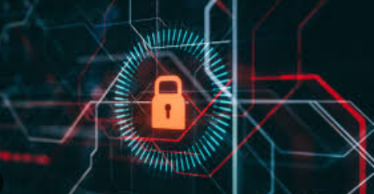

Slide 12
Hacking as Foreign Policy
Cyber Warfare
Governments sometimes use hacking for national security or intelligence purposes.
Uses
Espionage (stealing classified information)
Disrupting infrastructure
Influencing elections
Examples
Cyber attacks on power grids
Government-sponsored cyber espionage
Concerns
International conflict
Cyber arms race
Difficulty in attribution

Slide 13
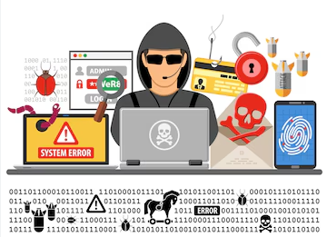

Slide 14
The Law: Catching and Punishing Hackers
Cybercrime Laws Governments have introduced laws to punish cybercriminals.
Key Legal Measures
Computer misuse laws
Cybercrime investigation units
Digital evidence collection
Challenges
Hackers hide identities
Cross-border crimes
Rapidly evolving technology
Punishments
Fines
Imprisonment
Asset confiscation

Slide 15
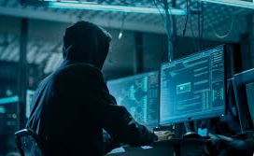

Slide 16
Identity Theft and Credit Card Fraud
Identity Theft
When someone steals personal information to impersonate another person.
Common Targets
Bank accounts
Credit cards
Social security numbers
Methods
Phishing emails
Data breaches
Malware
Consequences
Financial loss
Damaged credit history
Privacy violations

Slide 17
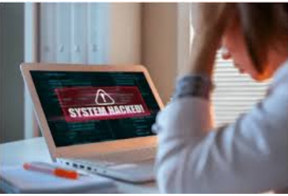

Slide 18
Stealing Identities
Definition
Criminals obtain personal data such as:
Names
CNIC numbers
Bank details
Passwords
Sources
Social media
Data breaches
Public databases
Uses
Fraudulent transactions
Opening fake accounts
Identity impersonation

Slide 19
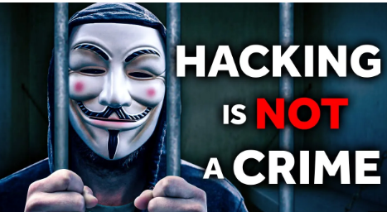

Slide 20
Responses to Identity Theft
Personal Protection
Strong passwords
Two-factor authentication
Regular credit monitoring
Institutional Measures
Fraud detection systems
Secure payment technologies
Customer verification processes
Government Role
Cybercrime laws
Consumer protection regulations
Cybercrime investigation agencies

Slide 21
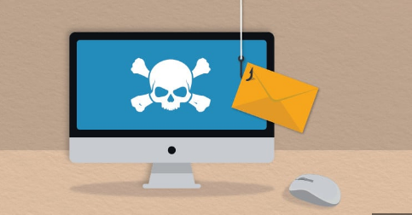

Slide 22
Biometrics
Definition
Biometrics uses unique biological characteristics for identification.
Examples
Fingerprints
Facial recognition
Iris scans
Voice recognition
Advantages
Strong authentication
Hard to duplicate
Convenient for users
Concerns
Privacy issues
Data misuse
Biometric database breaches

Slide 23
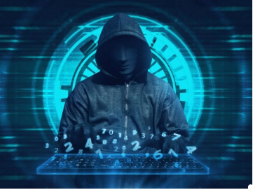

Slide 24
Whose Laws Rule the Web?
Global Nature of the Internet
Internet operates across national borders.
Problem Different countries have different laws regarding:
Privacy
Cybercrime
Content regulation
Example A website hosted in one country may violate laws in another country.
Key Question Which country's law should apply?

Slide 25
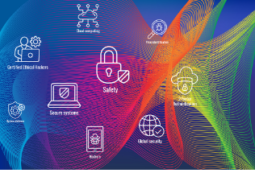

Slide 26
When Digital Actions Cross Borders
Cross-Border Cybercrime
Many cybercrimes occur across multiple countries.
Challenges
Jurisdiction issues
International cooperation
Evidence sharing
Solutions
International treaties
Cybercrime cooperation agreements
Global law enforcement collaboration

Slide 27
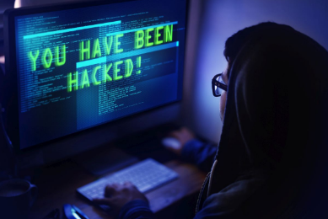

Slide 28
Libel, Speech, and Commercial Law
Libel
Publishing false statements that harm someone's reputation.
Online Speech
Social media raises issues of:
Freedom of speech
Hate speech
Fake news
Commercial Law Online
E-commerce regulations
Consumer protection
Digital contracts

Slide 29
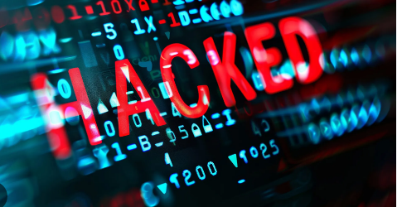

Slide 30
Culture, Law, and Ethics
Different Cultural Values
What is acceptable online varies by culture.
Examples
Free speech laws differ worldwide
Privacy expectations vary
Ethical Issues
Responsible technology use
Respect for privacy
Avoiding harm through digital actions

Slide 31
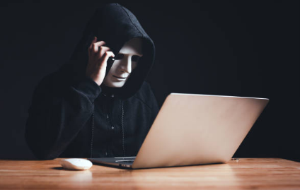

Slide 32
Potential Solutions
Improving Cybersecurity
Strong encryption
Advanced security systems
International Cooperation
Global cybercrime laws
Information sharing between countries
Public Awareness
Cybersecurity education
Safe internet practices
Technological Solutions
AI-based threat detection
Multi-factor authentication
Secure digital identity systems

Slide 33
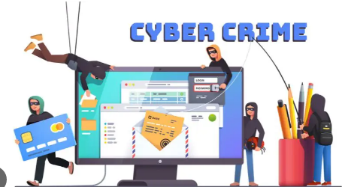

Slide 34
Case Study: The Cyber Attack on GlobalTech Corporation
Background
GlobalTech Corporation is a multinational technology company that provides cloud services, e-commerce platforms, and digital payment systems. Millions of customers worldwide use its services to store personal data, make online purchases, and conduct financial transactions.
One day, GlobalTech discovered that its systems had been compromised by a group of hackers. The attackers gained unauthorized access to customer databases and stole thousands of users’ personal identities, including credit card details, addresses, and login credentials.

Slide 35
Case Study: The Cyber Attack on GlobalTech Corporation
Shortly after the breach, some of the stolen data appeared online. Investigators later found that the attackers were part of a hacktivist group protesting against GlobalTech’s alleged involvement in government surveillance programs.
The hackers claimed that their actions were meant to expose unethical practices and raise awareness about privacy violations. However, the breach also resulted in serious consequences for customers, including identity theft and credit card fraud.
Authorities from several countries began investigating the case because the hackers operated from different countries, the company’s servers were located in multiple regions, and the victims were spread across the globe.

Slide 36
Case Study: The Cyber Attack on GlobalTech Corporation
1. What type of hacking occurred in this case?
Answer: This case involves unauthorized access to computer systems and databases, which is a form of hacking. The hackers exploited vulnerabilities in GlobalTech’s network security to gain access to sensitive customer data.
2. How does this case demonstrate hacktivism?
Answer: The attackers claimed they were protesting against GlobalTech’s alleged cooperation with government surveillance programs. Using hacking to promote a political or social cause is known as hacktivism.

Slide 37
Potential Solutions
3. How could ethical hackers or security researchers have helped prevent this attack?
Answer: Ethical hackers could have:
Conducted penetration testing
Identified vulnerabilities in the company’s systems
Reported weaknesses through responsible disclosure
This would allow GlobalTech to fix security flaws before attackers exploited them.
4. How can hacking be used as a foreign policy tool?
Answer: Governments sometimes support cyber operations to gather intelligence, influence political situations, or disrupt foreign systems. If a government had secretly supported the hackers in this case, it could represent cyber warfare or cyber espionage.

Slide 38
Potential Solutions
5. What laws apply to catching and punishing the hackers?
Answer: Cybercrime laws such as:
Computer misuse laws
Data protection laws
Fraud and identity theft laws
Law enforcement agencies can investigate the attack, collect digital evidence, and prosecute those responsible.
6. What is identity theft and how did it occur in this case?
Answer: Identity theft occurs when criminals steal personal information and use it to impersonate someone else. In this case, hackers stole customers’ names, credit card numbers, and addresses, which could be used for fraudulent transactions.

Slide 39
Potential Solutions
7. What is credit card fraud and how might criminals use the stolen data?
Answer: Credit card fraud occurs when someone uses another person’s credit card details without permission. Criminals could:
Make unauthorized purchases
Transfer money
Create fake accounts for financial transactions
8. What steps should victims take in response to identity theft?
Answer: Victims should:
Report the fraud to their bank immediately
Change passwords
Monitor credit reports
Enable two-factor authentication
Report the incident to cybercrime authorities

Slide 40
Case Study: The Cyber Attack on GlobalTech Corporation
9. How could biometric security help prevent such incidents?
Answer:
Biometric systems such as fingerprints, facial recognition, or iris scans can strengthen security because they rely on unique physical characteristics. Even if passwords are stolen, biometric verification can prevent unauthorized access.

Slide 41
Case Study: The Cyber Attack on GlobalTech Corporation
10. Why is it difficult to determine whose laws apply in this case?
Answer: The internet operates globally. In this case:
Hackers were in different countries
The company’s servers were located internationally
Victims were worldwide
This creates jurisdiction problems, making it difficult to determine which country’s laws apply.
11. How do digital actions crossing borders complicate cybercrime investigations?
Answer: Cross-border cybercrime investigations are difficult because:
Countries have different legal systems
Evidence may be stored internationally
Cooperation between law enforcement agencies is required

Slide 42
Case Study: The Cyber Attack on GlobalTech Corporation
12. How could libel, speech, and commercial law issues arise in this situation?
Answer: If the hackers published allegations about GlobalTech online, it could raise libel issues if the claims were false. Additionally, commercial laws may apply because customer financial information and e-commerce transactions were affected.
13. How do culture, law, and ethics influence perspectives on this case?
Answer: Different societies may view hacktivism differently. Some may see it as digital protest, while others consider it illegal cybercrime. Ethical perspectives also vary regarding privacy, activism, and corporate responsibility.

Slide 43
Case Study: The Cyber Attack on GlobalTech Corporation
14. What are potential solutions to prevent such cyber incidents in the future?
Answer: Possible solutions include:
Strong cybersecurity systems
Encryption and multi-factor authentication
Ethical hacking and security audits
International cooperation against cybercrime
Public awareness about cybersecurity risks

Slide 44


Slide 45


